Slide 1
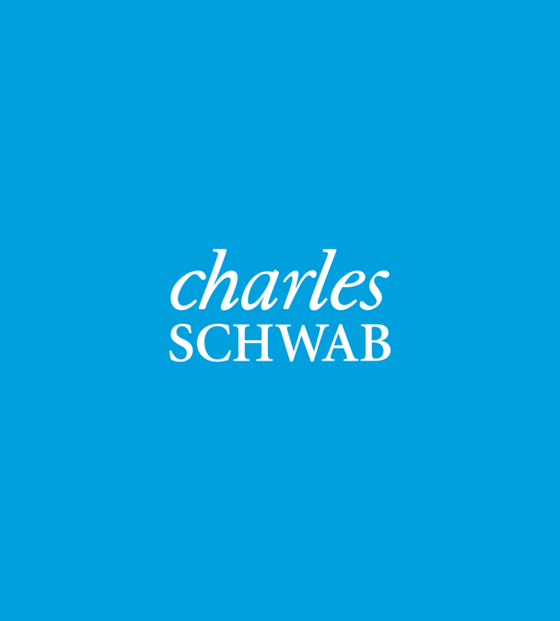
161 Madison Ave, Ste 230 Morristown, NJ 07960
Main Telephone: (862) 221-5581
Fax: (973) 267-0341
cornerstone-wealthassociates.com
Securities offered through Regulus Financial Group, LLC, Member FINRA /SIPC. Advisory services offered through Regal Investment Advisors, LLC an SEC Registered Investment Advisor. Regal Financial Group, Regal Investment Advisors and Regulus Financial Group are affiliated entities. Registration with the SEC does not imply any
level of skill or training. Cornerstone Wealth Associates is independent of Regal Financial Group, Regal Investment Advisors and Regulus Financial Group.
Notes:
Note title
Type your notes here. They will be viewable in presenter view.

Slide 2
Retirement
Pre-Retirement
(Accumulation Phase)
Post-Retirement
(Decumulation Phase)
IRA
Social Security
Market Risk
403(b)
Taxes
Inflation
401(k)
Longevity and Health Risk
Working/Saving $
Focus:
Growing Out Nest Egg
Retirement
Focus:
Growing and Preserving our Nest Egg
Notes:
Note title
Type your notes here. They will be viewable in presenter view.

Slide 3
Piecemeal Financial Approach
Cornerstone Financial Approach
Goals
&
Objectives
Income Tax
(Accountant)
Strategic
Retirement
Estate Planning
Strategies
Business
Continuity
Strategies
Fringe
Benefit
Planning
Strategies
College Funding
Planning
Goals
&
Objectives
C.D.s
Pensions, IRAs, 401(k)
(Benefits Consultant)
Wills
(Attorney)
Income
Tax
Strategy
Strategic
Investment
Strategic
Insurance
Buy-Sell
Agreements
(Attorney)
College Costs
(Self)
Notes:
Note title
Type your notes here. They will be viewable in presenter view.

Slide 4
The Cornerstone Process
On-going review of client objectives, changing environment and new regulations
Define Goals & Objectives/Data Gathering
Introductory
Meeting
Analysis & Strategy Development
Presentation to Client
Implementation
Describe Services Provided by Cornerstone
Collect All
Necessary
Financial
Information
Team Analysis and Review & Strategic Plan Development
Explanation of Strategic Plan Details and Rationale
Plan Recommendations Are Implemented
Notes:
Note title
Type your notes here. They will be viewable in presenter view.

Slide 5
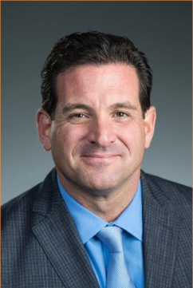
Robert G. Belcuore
Founder and Managing Partner
Financial Representative
161 Madison Ave, Suite 230 Morristown, NJ 07960
Direct Line: (973) 418-4841
Direct Fax: (973) 267-0341
Robert Belcuore founded Cornerstone in 2010 based on the core values of education, protection, and a servant's heart for all his client's financial needs. Robert developed his unique ability to communicate and demystify complex investment and financial concepts, making them easier for clients to understand, while spending eighteen years teaching in the public school system. Since then, Robert has educated thousands of individuals on lasting investment strategies for retirement, social security planning, estate planning, and tax saving strategies through public seminars. In addition Robert has individually met with hundreds of people for personalized financial planning from a wide variety of unique situations. Robert Received a masters degree from Jersey City State College, a doctorate equivalent degree in Educational Administration from Montclair State University in Pedagogy, and completed his undergraduate studies in political science at The University of Connecticut. These values, experiences, and education give Robert a perspective on financial planning that make him uniquely qualified to help you achieve your retirement and financial dreams. Robert now lives in Millburn, NJ with his wife, Loraine, and their three daughters. Robert's favorite roll in life is being the father of his daughters Faith, Ava, and Alexa. Robert played football while attending The University of Connecticut where he was voted captain by his teammates and achieved All American status as a player and was a member of the Dallas Cowboys after graduating. Robert is also a Deacon and Board Member at The Life Christian Church.
It is not our position to offer tax advice. Please consult with your own Accountant prior to making any decisions regarding your own situation.
Notes:
Note title
Type your notes here. They will be viewable in presenter view.

Slide 6
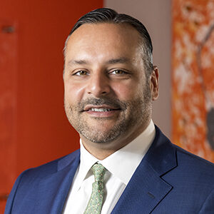
Jose Luis Blanco
Financial Representative
Cornerstone Financial
161 Madison Ave, Suite 230 Morristown, NJ 07960
Direct Line: (201) 686-6269
Jose Luis has over 25 years of experience as a Financial Representative. Through his core mission, Jose Luis establishes trust, instills confidence and always strives to make a positive impact on the lives of his clients. As part of his comprehensive financial services, individuals and businesses are accustomed to a very proactive and tailored approach, from in depth analysis and investment management consultation, retirement and insurance strategies to legacy protection. In his spare time, Jose Luis enjoys giving back to the community through athletic oriented-charities supporting autism, multiple sclerosis and various others. Jose Luis is also an avid sports enthusiast with specific interest in football, basketball, and golf. Jose Luis has a son Aaron and his daughter Olivia. Professional Certifications include Series 7, Series 63, Series 3, & Series 65
Life, Health & Accident Insurance Licenses include the states of NJ, NY, PA, OH, FL, CO, CA, MD, VA, & MA, GA, AL, IL, CT
It is not our position to offer tax advice. Please consult with your own Accountant prior to making any decisions regarding your own situation.
Notes:
Note title
Type your notes here. They will be viewable in presenter view.

Slide 7
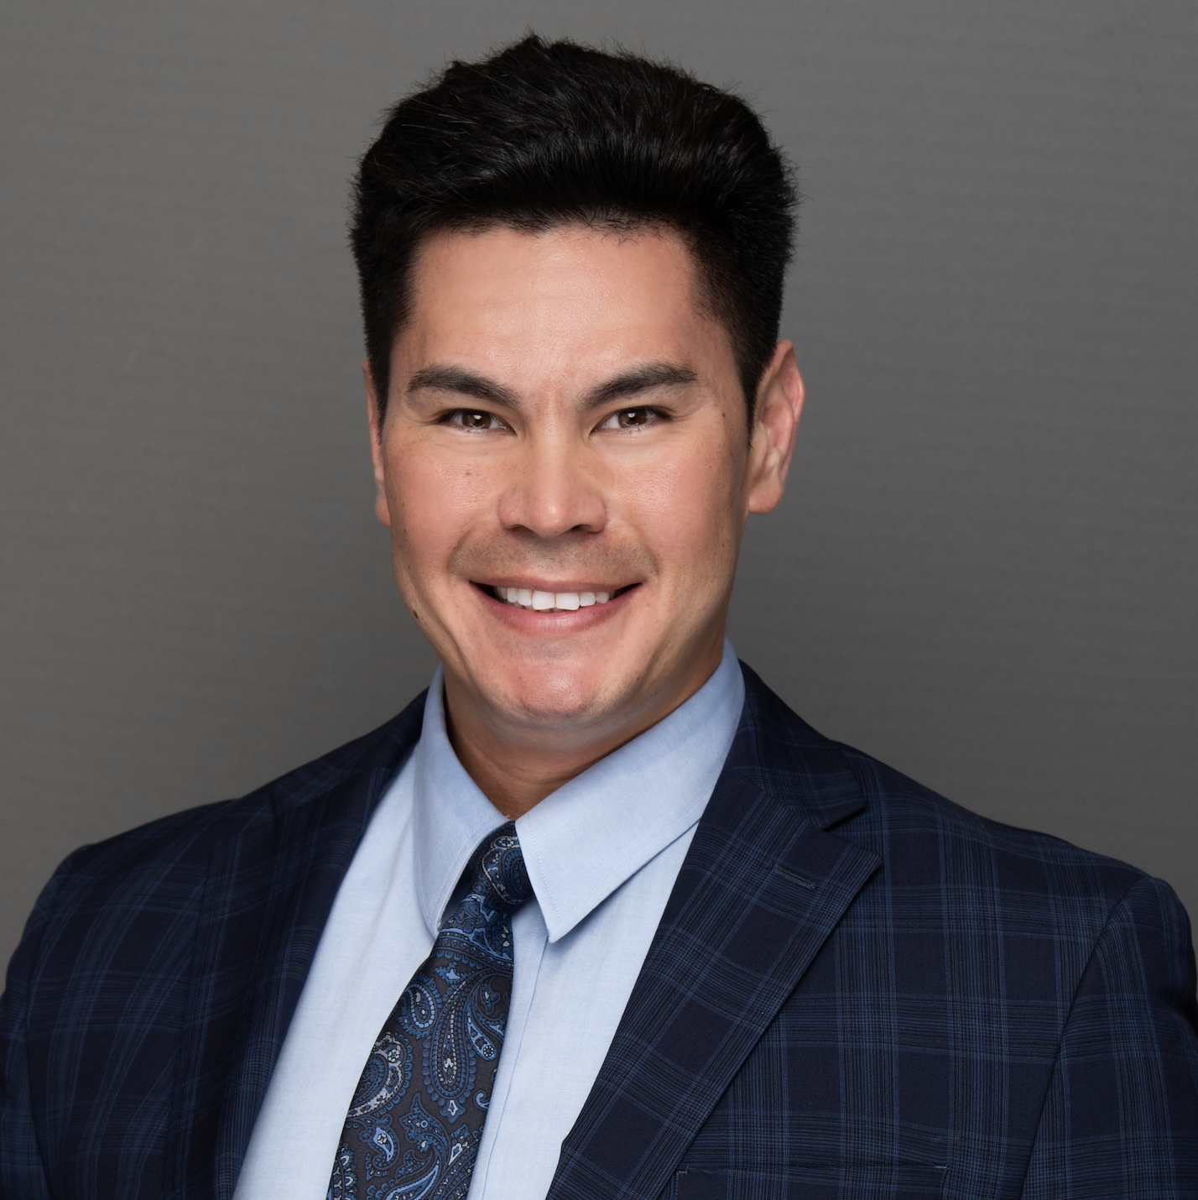
Matthew Mortillaro
Financial Advisor
Senior Relationship Manager
161 Madison Ave, Suite 230 Morristown, NJ 07960
Direct Line: (973) 271-0335
Direct Fax: (973) 267-0341
Matthew’s client philosophy is deeply influenced by his father’s example of work ethic and dedication to excellence as a union 164 electrician and a US Army veteran. He gave Matthew a deep-rooted foundational belief of the importance of honesty, transparency, and above all, doing right by the clients that entrust their dreams to his financial planning and guidance. Matthew’s father also provided an example of proper financial planning, when after his unexpected death, Matthew, his mother and two younger brothers found that their father had left them with enough life insurance, investments, and support from union 164 so that they would not have to worry about their financial security. Matthew and Cornerstone prioritize their clients’ needs, collaborating closely to craft tailored plans. These not only meet immediate objectives but also amplify earnings and savings through distinctive and often underutilized risk management and tax-reduction methods using tax-deferred and Roth retirement accounts and planning withdrawals to remain in a lower tax bracket. Their goal is to help clients earn more and retain more! Aside from being a partner to his firm, Matthew is a New Jersey resident who graduated from Montclair State University. In his spare time, Matthew’s hobbies include exercising and physical fitness, sunny days at the beach, spending time with family, hiking, horseback riding, snowmobiling, and is currently studying for his CFP designation.
Investment advisory services provided by Regal Investment Advisors, LLC, an SEC Registered Investment Advisor. Regal Investment Advisors is independent of [Cornerstone Wealth Associates].
Securities offered through Regulus Financial Group, LLC. Member FINRA / SIPC. Cornerstone Wealth Associates, LLC is independent of Regulus Financial Group.
Do not transmit orders or instructions regarding your account by email. For your protection, we cannot accept or act on such instructions. Similarly Cornerstone Wealth Associates, LLC does not accept trading instructions via voicemail, text messages, instant messaging, or facsimile. Please speak directly with your Representative if you need to give instructions related to your account.
Notes:
Note title
Type your notes here. They will be viewable in presenter view.

Slide 8
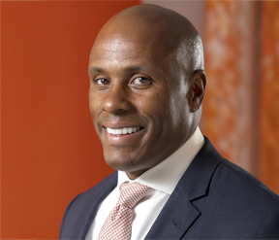
Leonard Dandridge
Financial Advisor
Director of Expansion
161 Madison Ave, Suite 230 Morristown, NJ 07960
Direct Line: (732) 853-3463
Direct Fax: (973) 267-0341
Prior to joining Cornerstone Wealth Associates, Leonard was a corporate sales professional/consultant for 25 plus years where he was a top producer in Medical Device, IT, Health and Wellness, and most recently Financial Services. Mr. Dandridge has been a top producer in all areas because of his passion for the people he serves.
Leonard received a master’s degree in Education from the University of Bridgeport. He completed his undergraduate studies with a BS in Marketing with minors in Economics and Finance at the University of Connecticut.
Lenny now lives in Somerset, NJ with his wife of 17 years, Nicole and their two children son Brock (16) and daughter Cienna (14).
Investment advisory services provided by Regal Investment Advisors, LLC, an SEC Registered Investment Advisor. Regal Investment Advisors is independent of [Cornerstone Wealth Associates].
Securities offered through Regulus Financial Group, LLC. Member FINRA / SIPC. Cornerstone Wealth Associates, LLC is independent of Regulus Financial Group.
Do not transmit orders or instructions regarding your account by email. For your protection, we cannot accept or act on such instructions. Similarly Cornerstone Wealth Associates, LLC does not accept trading instructions via voicemail, text messages, instant messaging, or facsimile. Please speak directly with your Representative if you need to give instructions related to your account.
Notes:
Note title
Type your notes here. They will be viewable in presenter view.

Slide 9
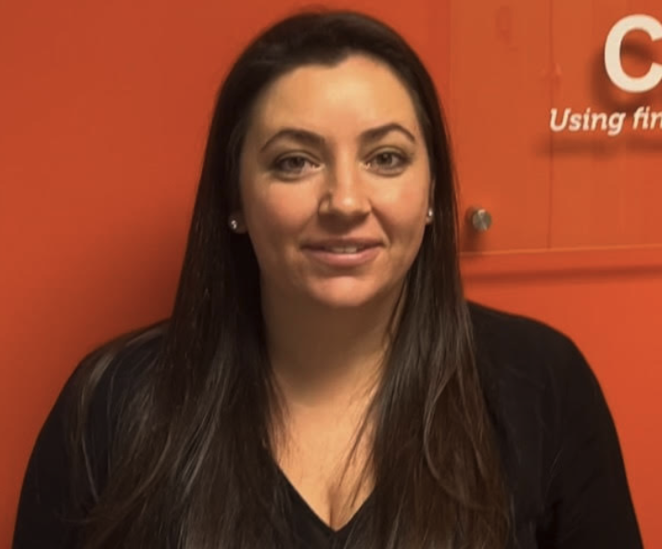
Ashley Mariani
Financial Professional
161 Madison Ave, Suite 230 Morristown, NJ 07960
Direct Line: (973) 865-3888
Direct Fax: (973) 267-0341
Ashley Mariani is a financial professional at Cornerstone Wealth Associates – an independent financial firm focused on wealth protection and financial retirement planning. With an extensive knowledge base, strong integrity, and years of experience she helps individuals achieve their financial goals. Each client has individual needs which she uncovers through active listening. Her specialties consist of retirement planning and special needs planning. She helps individuals navigate the transition into retirement by providing financial guidance so they can focus on the important things they enjoy with less stress. She delivers exceptional client experience by ensuring all her clients receive the utmost level of service, attention, and care.
Outside of her professional life, Ashley loves going to the beach with her family. Being present, going on new adventures, creating memories and maintaining family traditions have always been a priority for her. Ashley graduated cum laude from Roger Williams University’s AACSB accredited Gabelli School of Business with a Bachelor of Science in Marketing and Spanish.
Ashley is passionate about Exceptional Parent Magazine. EP Magazine provides practical advice, emotional support, and the most up-to-date educational information for families of children and adults with disabilities and special healthcare needs.
Ashley enjoys cultivating long-lasting relationships with her clients. Her commitment to helping people has allowed her to positively impact the lives of many clients.
Investment advisory services provided by Regal Investment Advisors, LLC, an SEC Registered Investment Advisor. Regal Investment Advisors is independent of [Cornerstone Wealth Associates].
Securities offered through Regulus Financial Group, LLC. Member FINRA / SIPC. Cornerstone Wealth Associates, LLC is independent of Regulus Financial Group.
Do not transmit orders or instructions regarding your account by email. For your protection, we cannot accept or act on such instructions. Similarly Cornerstone Wealth Associates, LLC does not accept trading instructions via voicemail, text messages, instant messaging, or facsimile. Please speak directly with your Representative if you need to give instructions related to your account.
Notes:
Note title
Type your notes here. They will be viewable in presenter view.

Slide 10
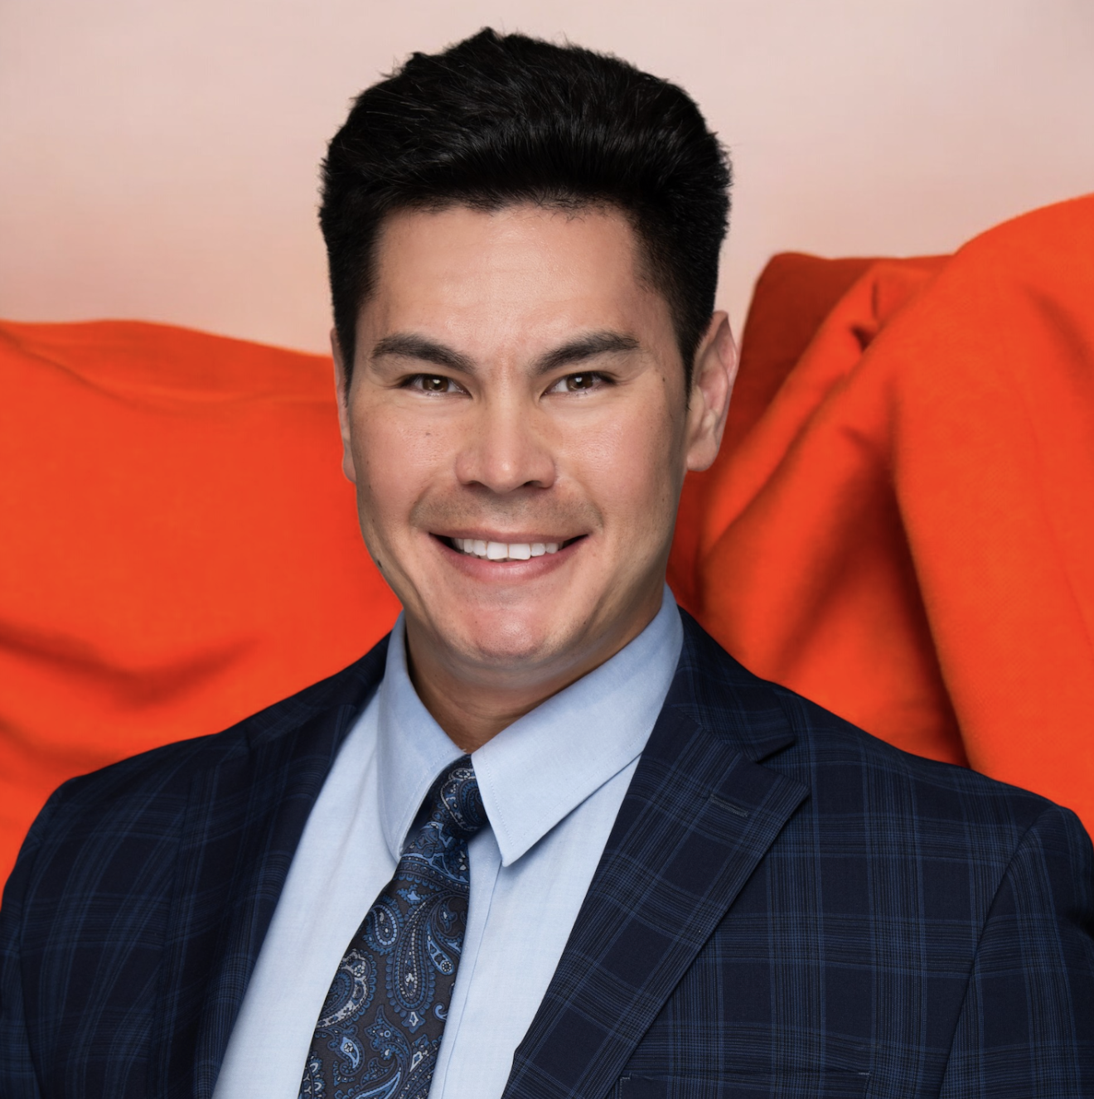
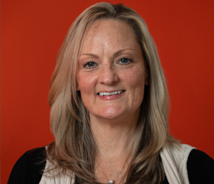
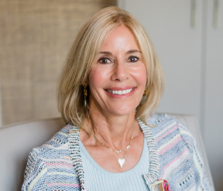
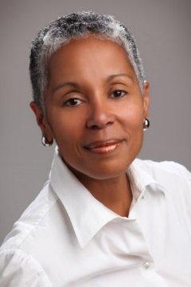
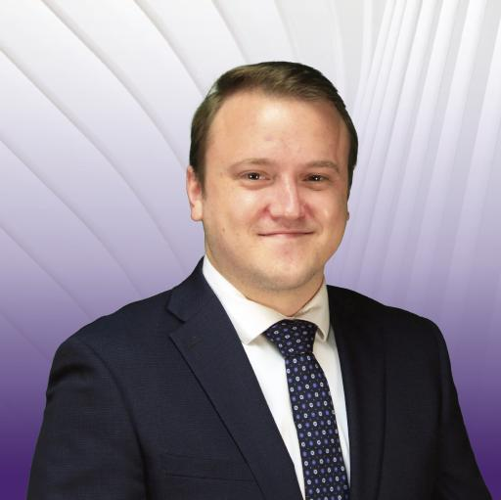
Cornerstone Wealth Associates
Team of Financial Professionals
Robert G. Belcuore
Founder and Managing Partner
Financial Representative
161 Madison Ave, Suite 230
Morristown, NJ 07960
Direct Line: (973) 418-4841
Direct Fax: (973) 267-0341
Jose Luis Blanco
Financial Professional
Matthew Mortillaro
Financial Advisor
Lenny Dandridge
Financial Advisor
Ashley Mariani
Financial Professional
Loraine Morgenroth
Client Relationship Manager
Diane Goldman
Social Security Specialist
CPA
Specialist for Cornerstone Wealth Associates
Cheryl Crawford
Social Security Specialist
CPA
Specialist for Cornerstone Wealth Associates
Jordan Fischer CFP®, AIF®
Portfolio Manager
Regal Financial Group
Securities offered through Regulus Financial Group, LLC, Member FINRA /SIPC. Advisory services offered through Regal Investment Advisors, LLC an SEC Registered Investment Advisor. Regal Financial Group, Regal Investment Advisors and Regulus Financial Group are affiliated entities. Registration It is not our position to offer tax advice. Please consult with your own Accountant prior to making any decisions regarding your own situation.
Securities offered through Regulus Financial Group, LLC. Member FINRA/SIPC. Investment advisory services offered through Regal Investment Advisors, LLC, a SEC Registered Investment Advisor. Regulus Financial Group, LLC and Regal Investment Advisors are affiliated. Registration with the SEC does not imply any level of skill or training. Do not transmit order or instructions regarding your account by email. For your protection, your Financial Representative cannot accept or act on such instructions. Similarly, Regal Financial Group does not accept trading instructions via voicemail, text messages, instant messaging, or facsimile. Please speak directly with your Financial Representative if you need to give instructions to your account. This message and any attachments contain information from Regal Holdings, Regal Financial Group, Regal Investment Advisors, and/or Regulus Financial Group which may be confidential and/or privileged and is intended for use only by the addressee(s) named on this transmission. If you are not the intended recipient, or the employee or agent responsible for delivering the message to the intended recipient, you are notified that any review, copying, distribution or use of this transmission is strictly prohibited. If you have received this transmission in error, please (i) notify the sender immediately by e-mail or by telephone and (ii) destroy all copies of this message.
with the SEC does not imply any
level of skill or training. Cornerstone Financial Services Group is independent of Regal Financial Group, Regal Investment Advisors and Regulus Financial Group.
Notes:
Note title
Type your notes here. They will be viewable in presenter view.

Slide 11
Roadblocks in Retirement
(‘Retirement Landmines’)
Longevity Risk (‘Outliving Your Money’)
Health Risk (‘Long Term Care, Critical Illness, Critical Injury’)
Mortality Risk (‘a Death that Affects Your Income, i.e. Social Security)
Inflation Risk
Tax Risk (Income Tax from Pre-Tax Vehicles)
Market Risk (Sequence Risk ~Example on Next Page~)
It is not our position to offer tax advice. Please consult with your own Accountant prior to making any decisions regarding your own situation.
Notes:
Note title
Type your notes here. They will be viewable in presenter view.

Slide 12
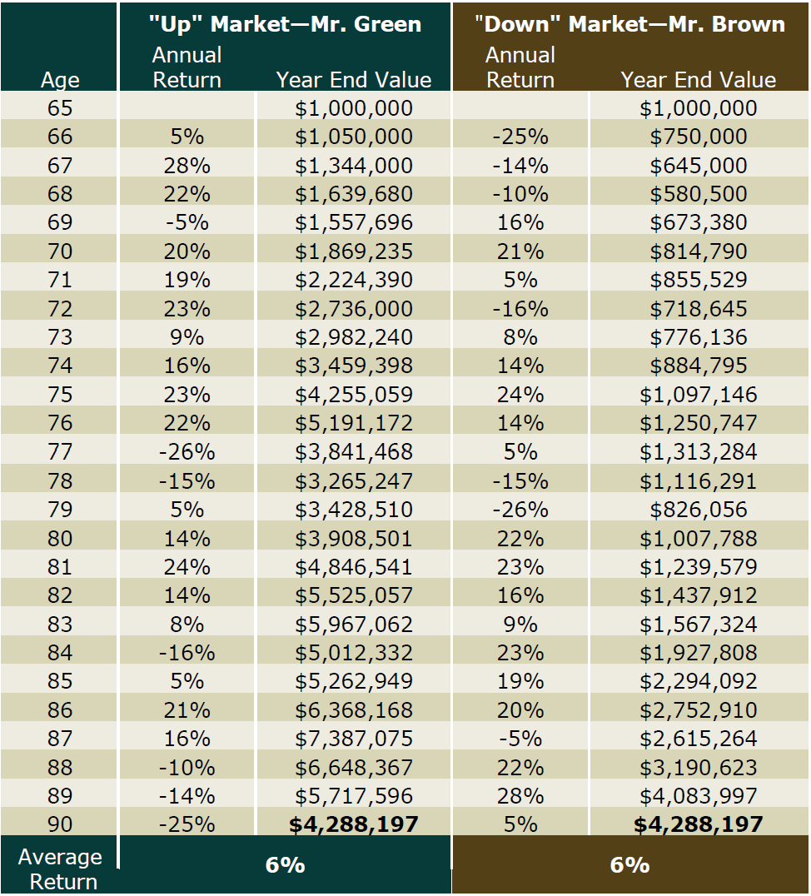
Sequence Risk No Distributions
This is a hypothetical example for illustrative purposes
Notes:
Note title
Type your notes here. They will be viewable in presenter view.

Slide 13
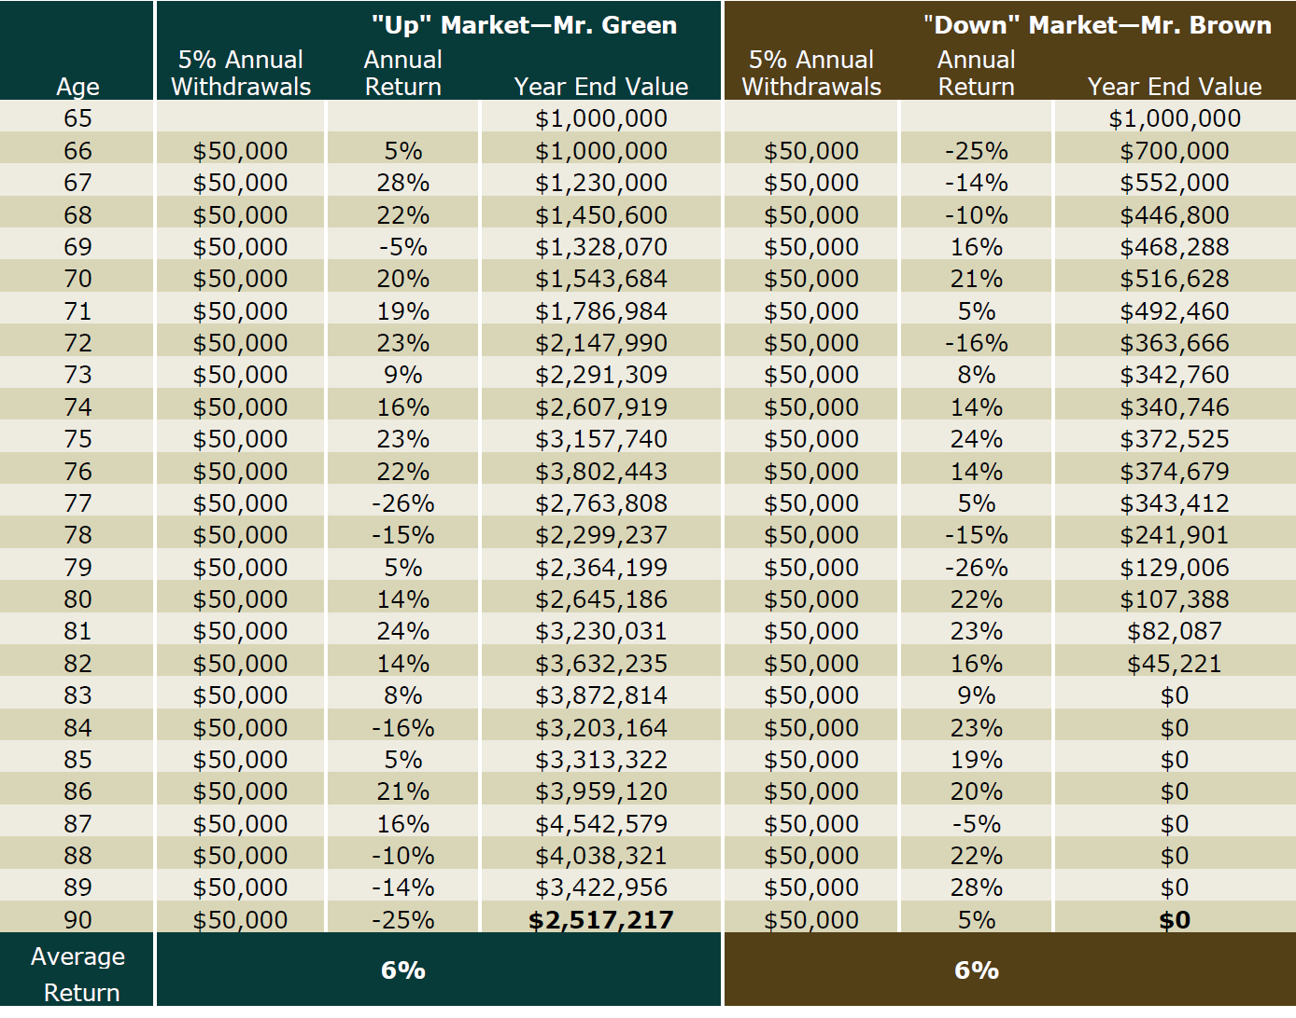
Sequence Risk Taking Distributions
This is a hypothetical example for illustrative purposes
Notes:
Note title
Type your notes here. They will be viewable in presenter view.

Slide 14
Thank You!
Securities offered through Regulus Financial Group, LLC, Member FINRA /SIPC. Advisory services offered through Regal Investment Advisors, LLC an SEC Registered Investment Advisor. Regal Financial Group, Regal Investment Advisors and Regulus Financial Group are affiliated entities. Registration with the SEC does not imply any
level of skill or training. Cornerstone Wealth Associates is independent of Regal Financial Group, Regal Investment Advisors and Regulus Financial Group.
Notes:
Note title
Type your notes here. They will be viewable in presenter view.

